Slide 2
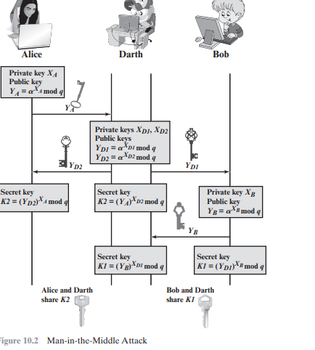

Slide 3
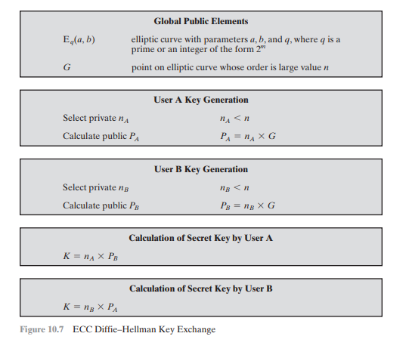

Slide 4
The cryptosystem parameters are E11(1, 6) and G = (2,7). B’s private key is nB = 7.
Find B’s public key PB.
A wishes to encrypt the message Pm = (10, 7) and chooses the random value k = 3. Determine the cipher text Cm.

